Slide 1
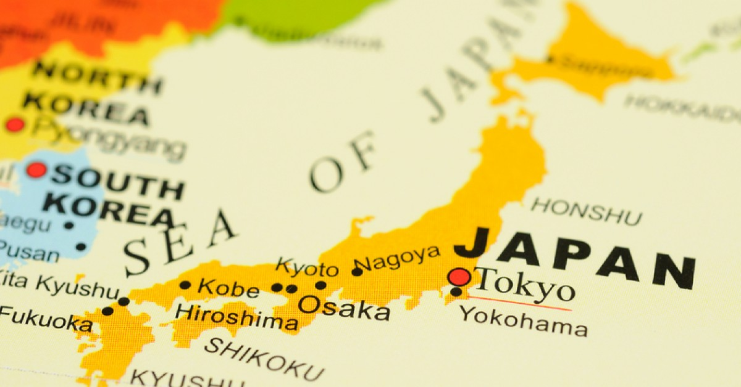
KEY FEATURES AND CULTURE
By Callum Edwards

Slide 2
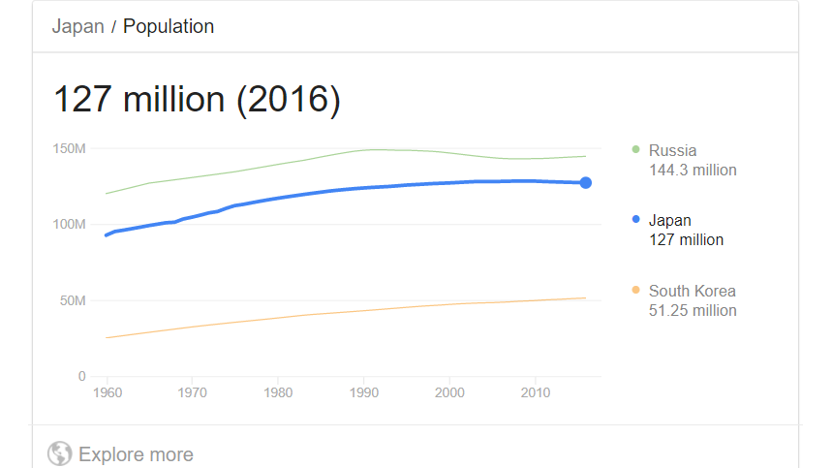
Statistics
Population: 127,366,388
The population of Japan has increased from 92.5 million in 1960 to 127.36 million in 2017

